Slide 1
Reporting procedure to the treaty bodies (UN bodies)
Study visit - delegation from
Kosovo
April 9, 2013
Notes:
1

Slide 2
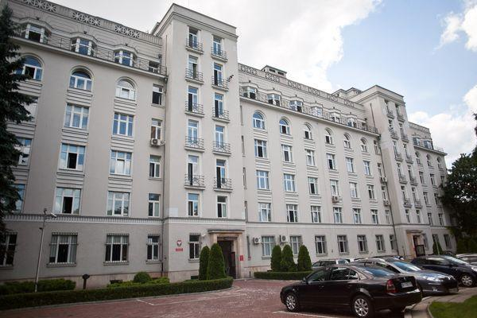
Ministry of Justice

Slide 3
Ministry of Justice
Organisational units subordinate to or supervised by the Minister of Justice:
Department of Civil Law
Department of Criminal Law
Central Authority of the Prison Service
Department of Courts, Organisation and Judical Analysis
the Institute of Justice
Department of Enforcement of Judgements and Probation
Department of International Cooperation and Human Rights
the National School of Judiciary and Public Prosecution (KSSiP)
The Minister’s Bureau

Slide 4
Department of International Cooperation and Human Rights
Treaties Division
International Law Division
International Procedures of Human Rights Protection Division
Proceedings before the European Court of Human Rights Division
Crime Victims and Promotion of Mediation Division incl. the Promotion of Mediation Section
Prevention of Domestic Violence Division

Slide 5
Division III: International Procedures of Human Rights Protection
1. Drawing up national reports submitted to Committee against Torture and Human Rights Committee on the measures which Poland has taken to give effect to its undertakings under the UN’:
Convention Against Torture (…) - CAT
International Covenant on Civil and Political Rights - ICCPR

Slide 6
Division III: International Procedures of Human Rights Protection
2. Preparing contributions to the national reports in the field of justice submitted to:
other treaty bodies (the UN’ bodies):
Committee on the Elimination of Discrimination against Women (CEDAW)
Committee on the Elimination of Racial Discrimination (CERD)
Committee on the Rights of the Child (CRC)
Committee on Economic, Social and Cultural Rights (CESCR)
Council of Europe’s bodies, e.g.:
European Committee of Social Rights (the European Social Charter)
European Commission against Racism and Intolerance (ECRI)

Slide 7
Division III: International Procedures of Human Rights Protection
3. Cooperation with international and national human rights bodies, e.g.
Committee for the Prevention of Torture and Inhuman and Degrading Treatment or Punishment (Council of Europe’s body)
Position of a „liaison officer”
Drafting national statements to its reports after Committee’s visits in Polish places of detention
Committee on Bioethics (DH-BIO)
Participation in drafting bioethical instruments
National Preventive Mechanism
Drawing up opinions to its reports

Slide 8
Division III: International Procedures of Human Rights Protection
4. Analyzing the compliance of the national law with the international human rights standards in order to draft opinion about legitimacy to sign and ratify the international human rights convention as well as submit reservation, e.g.:
UN Convention on the Rights of Persons with Disabilities (CRPD)
UN International Convention for the Protection of All Persons from Enforced Disappearances (CED)
Convention for the Protection of Human Rights and Dignity of the Human Being with regard to the Application of Biology and Medicine: Convention on Human Rights and Biomedicine

Slide 9
Division III: International Procedures of Human Rights Protection
5. Disseminating and promoting the international human rights standards in the field of justice, e.g.:
Publishing studies on the UN’ human rights system (on the website of the Ministry of Justice)
Facilitating cooperation between the National School of Judiciary and Public Prosecution (KSSiP) and NGOs in human rights training (e.g. for the court's and prosecutor’s office’s spokespersons)

Slide 10
UN Conventions
Convention | In brief | Date of ratification by Poland | Treaty body | Reporting by Poland | Individual communication (v.Poland)
International Covenant on Civil and Political Rights (1966) | ICCPR | 1977 | Human Rights Committee | yes | yes (OP)
International Covenant on Economic, Social and Cultural Rights (1966) | ICESCR | 1977 | Committee on Economic, Social and Cultural Rights | yes | no (Optional Protocol)
Convention on the Elimination of All Forms of Racial Discrimination (1965) | CERD | 1968 | Committee on the Elimination of Racial Discrimination | yes | yes
Convention on the Elimination of All Forms of Discrimination against Women (1979) | CEDAW | 1980 | Committee on the Elimination of Discrimination against Women | yes | yes (OP)
Convention against Torture and Other Cruel, Inhuman or Degrading Treatment or Punishment (1984) | CAT | 1989 | Committee against Torture | yes | yes
Convention on the Rights of the Child (1989) | CRC | 1991 | Committee on the Rights of the Child | yes | - (OP - opened for ratification)
International Convention on the Protection of the Rights of All Migrant Workers and Members of Their Families (1990) | CMW | - | Committee on Migrant Workers | - | -
International Convention for the Protection of All Persons from Enforced Disappearances (2006) | CED | - | Committee on Enforced Disappearances | - | (there is possibility but we didn’t not ratify the Convention)
Convention on the Rights of Persons with Disabilities (2006) | CRPD | 2012 | Committee on the Rights of Persons with Disabilities | yes | no (Optional Protocol)

Slide 11
UN Conventions – reporting
Convention | the Ministry responsible for coordinating the work on preparing reports
ICCPR
CAT | the Ministry of Justice
ICESCR | the Ministry of Labour and Social Policy
CERD | the Ministry of the Interior
CEDAW | Government Plenipotentiary for Equal Treatment
CRC and II OP | the Ministry of National Education
CRPD | the Ministry of Labour and Social Policy

Slide 12
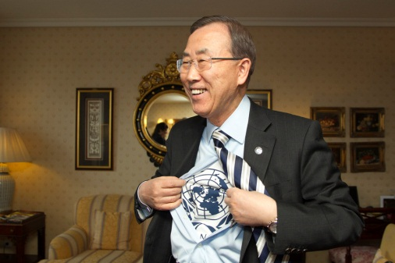
Reporting to the treaty-bodies - HRC (ICCPR) and CAT
Initial report – is due within 1 year after the entry into the force of the Convention or Covenant
Periodic reports – must be submitted to the Commitee:
every 4 years (CAT) – period is specified in the Convention (but the Committee may request other reports)
whenever the Committee so requests (ICCPR) – the date is contained in the concluding observations of HRC (after consideration of the report by the Committee, e.g. by 26 October 2015)

Slide 13
Initial report (CAT)
CAT – „Guidelines on the form and content of initial reports under article 19 to be submitted by State parties to the Convention against Torture” (CAT/C/4/Rev.3, 18 July 2005)
The content of the initial report:
I. General information
cross-reference to the expanded „core document” (information of general nature, such as the general political structure, general legal framework)
information on the process of preparing the report (broad-based consultations with: national institutions, NGOs, etc.)
general legal framework under which torture and other cruel, (…) treatment or punishment is prohibited (i. a. constitutional, criminal, administrative provisions, international treaties, competent authorities with jurisdiction mandate covering matters dealt with the Convention)

Slide 14
Initial report (CAT)
II. Information in relation to each substantive article of the Convention (16 articles)
the legislative, judicial, administrative or other measures giving effect to the provisions
cases and situations where those measures have been enforced (including statistical data)
cases and situations of violation of the Convention, the reasons for such violations and the measures taken to remedy the situation
Treaty body database: http://tb.ohchr.org/default.aspx

Slide 15
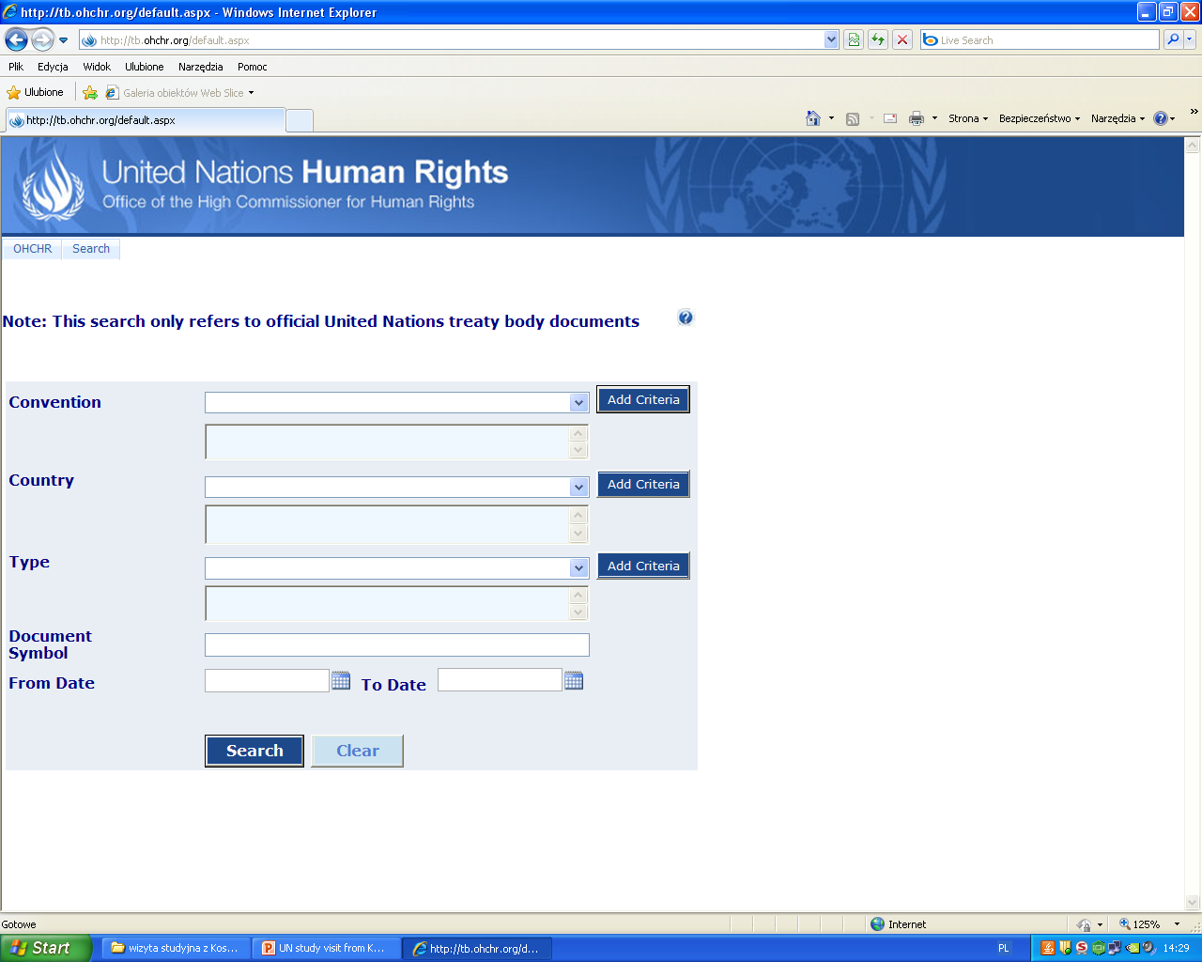

Slide 16
Procedure of reporting (CAT) – periodic reports
1) Standard procedure
2) LOIPR (list of issues prior to reporting)
the State prepares the report (on the basis of i.a. „concluding observations” after the consideration of the report by the Committee)
list of issues is submitted by a Committee to the State before the consideration of the report (with request to provide more specific information)
the States drafts the reply to the list of issues before the examination of the report and submits it to the Committee
the Committee examines the report at the presence of the delegation of the State („non-paper” document)
the Committe makes „concluding observations” (positive aspects, subject of concern and recommendations submitted to the State)
the request to provide a reply to some recommendations by the earlier date (than the periodic report) may be included in the „concluding observations” (e.g. reply to recommendation number 10, 12 and 18 within 1 year after acceptance of „concluding observation” by HRC)
the Committee submits to the State party a list of issues – guidance on the expected content of the periodic report
the State party prepares and submits to the Committee a report based on the list of issues
the Committee examines the report at the presence of the delegation of the State („non-paper” document)
the Committe adopts „concluding observations” (positive aspects, subject of concern and recommendations submitted to the State)

Slide 17
State’s report
Common core document
Treaty-specific document

Slide 18
Core document – general information
„Harmonized guidelines on reporting under the international human rights treaties, including guidelines on a core document and treaty – specific documents” (extract from HRI/GEN/2/Rev.6)
States should update the common core document whenever they submit a treaty-specific document
It should not exceed 60-80 pages
It must be submitted in one of official languages of the UN

Slide 19
Core document – the content
„Harmonized guidelines on reporting under the international human rights treaties, including guidelines on a core document and treaty – specific documents” (extract from HRI/GEN/2/Rev.6)
PART | Specific information | Core document of Poland (2012)
1. General information | Demographic, economic, social and cultural characteristics of the State Constitutional, political and legal structure of the State | Land and people The economy The reforms (administrative, social reform) The political system (legislative, executive and judicial authority)
2. General framework for the protection and promotion of human rights | Acceptance of international human rights norms Legal framework for the protection of human rights at the national level Framework within which human rights are promoted at the national level Reporting process at the national level Other related human rights information | V. Framework within which human rights are protected (means for the protection of rights and freedoms, Human Rights Defender, Commissioner for Children’s Rights, Commissioner for Patient’s Rights)
3. Information on non-discrimination, equality and effective remedies | Non-discrimination and equality Effective remedies | VI. Human rights under the Polish consitution VII. Promotion and teaching of human rights in Poland

Slide 20
The content of the treaty-specific document (CAT) „Harmonized guidelines on reporting under the international human rights treaties, including guidelines on a core document and treaty – specific documents” (extract from HRI/GEN/2/Rev.6)
1) Standard procedure
2) LOIPR (V and VI Periodic Report on the implementation of the provisions of CAT)
de jure and de facto situation
should indicate how legal instruments are reflected in the actual political, economic, social and cultural activities
should provide relevant statistical data, disaggregated by sex, age and population groups (they may be presented in tables annexed to the report)
recent developments in law and practice affecting the enjoyment of rights and implementation of the Convention (any legislation, new case, proceedings, sentences etc.)
any information requested by the Committee and not provided by the State party
response to issues raised by the Committee in its concluding observation or general comments
according to the „Harmonized guidelines…” it should contain all the information expected to be included in the standard report, however the report is based on the list of issues prepared by the Committee (…)

Slide 21
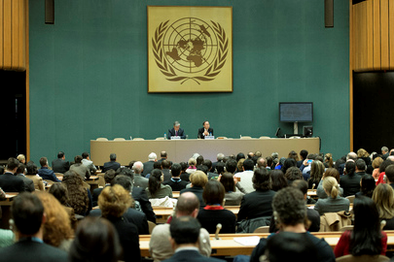
V and VI Periodic Report of the Republic of Poland on the implementation of the provisions of CAT
covering the period from 1 October 2004 until 15 October 2011
33 questions from the Committee related to 11 Articles of the Convention (answer to each question - in 33 sections)
94 pages + annexes (electronic form + printed paper copy)

Slide 22
the advantages of the LOIPR procedure
no further list of issues is submitted to the States parties before the consideration of its report (less work for the State)
the periodic report is shorter than the one drafted according to the standard procedure (it is drafted in a timely and effective matter)
reports received under this procedure are scheduled by the Committee for consideration as a matter of priority (it was like this in the past)

Slide 23
The process of preparing report by the Ministry of Justice submitted to CAT
consultations with national authorities:
other Departments in the Ministry of Justice and Central Authority of the Prison Service which tasks are connected with the list of issues (internal consultations)
other Ministries which tasks are related to the list of issues – also Human Rights Defender, Commissioner for Children’s Rights (external consultations)
consultations with NGOs:
all the issues contained in the report

Slide 24
The process of preparing report by the Ministry of Justice submitted to CAT - the issues of consultations
Departments in the Ministry of Justice:
1) definition of torture
2) pretrial detention
3) „hate crimes”
Central Authority of the Prison Service:
1) overcrowding in prisons
2) rights of prisoners

Slide 25
The process of preparing report by the Ministry of Justice submitted to CAT
Ministries and other national bodies:
1) Ministry of the Interior (e.g. the deportation of foreigners, trafficking in human beings)
2) Ministry of Labour and Social Policy (e.g. domestic violence)
3) Ministry of National Defence (e.g. hazing in the armed forces)
4) General Prosecutor’s Office (e.g. prosecution of „hate crimes”)
5) The Government Plenipotentiary for Equal Treatment (e.g. National Programme for Counteracting Racial Dicrimination (…))
Human Rights Defender:
1) the issue of National Preventive Mechanism
2) complaints submitted to the HRD

Slide 26
The process of preparing report by the Ministry of Justice submitted to CAT
NGOs:
Helsinski Foundation for Human Rights
Association of Legal Intervention
Campaign against Homofobia
We publish the documents related to this process:
http://bip.ms.gov.pl/pl/prawa-czlowieka/onz-i-prawa-czlowieka/wspolpraca-w-ramach-systemu-onz/

Slide 27
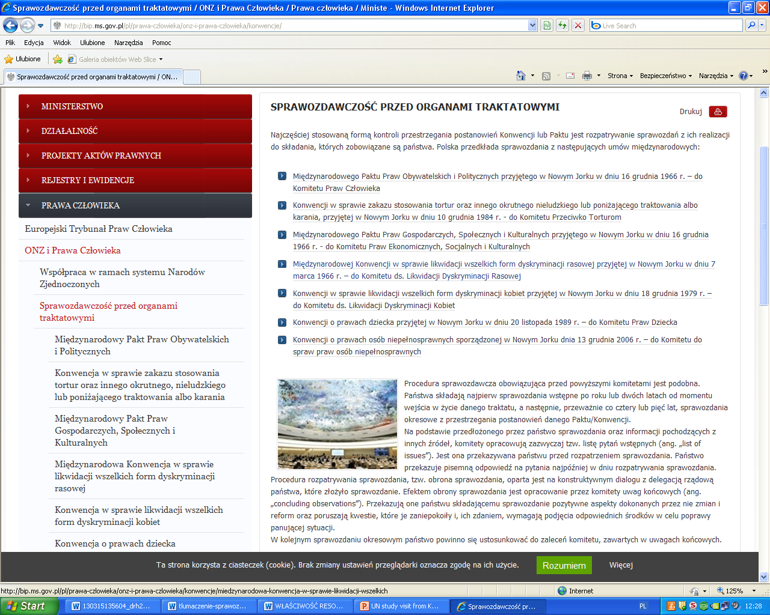

Slide 28
The process of preparing report by the Ministry of Justice submitted to CAT
the examination of the report by the Committee
collect information from national institutions in order to update or extend some information
search reports of NGOs about the situation in Poland
draft speech of the Chairman of the Polish delegation
The examination of V and VI report of the Republic of Poland on the implementation of the provisions of the
CAT will be held at the 51st session of the Committee (October-November 2013).

Slide 29
Thank you for your attention
Prepared by
Agnieszka Żygas

